Slide 1
Not FDIC/NCUA insured • May lose value • Not bank/CU guaranteed Not a deposit • Not insured by any federal agency
This presentation is meant to provide education on the content being presented and is intended for financial industry professionals. It is not intended for use with the general public.
Notes:
Welcome. I'm [Presenter Name] with Jackson. Today I want to talk about a topic that seems to be either misunderstood or severely oversimplified among the financial services industry, popular press, and even elite advisors—and that is the unique and very real challenge of retirement income planning.

Slide 2
Important Disclosures
Before investing, investors should carefully consider the investment objectives, risks, charges and expenses of the variable annuity and its underlying investment options. The current contract prospectus and underlying fund prospectuses, which are contained in the same document, provide this and other important information. Please contact your Internal Wholesaler to obtain the prospectuses. Please read the prospectuses carefully before investing or sending money.
This material was prepared to support the promotion and marketing of Jackson® variable annuities. Jackson, its distributors and their respective representatives do not provide tax, accounting or legal advice. Any tax statements contained herein were not intended or written to be used, and cannot be used, for the purpose of avoiding U.S. federal, state or local tax penalties. Clients should contact their own independent advisors as to any tax, accounting or legal statements made herein.
Variable annuities are long-term, tax-deferred investments designed for retirement, involve risks and may lose value. Earnings are taxable as ordinary income when distributed and may be subject to a 10% additional tax if withdrawn before age 59½.
Guarantees are backed by the claims-paying ability of the issuing insurance company.
Tax deferral offers no additional value if an annuity is used to fund a qualified plan, such as a 401(k) or IRA, and may be found at a lower cost in other investment products. It also may not be available if the annuity is owned by a “non-natural person” such as a corporation or certain types of trusts.
Notes:
Before we begin, I'd like to go over some important disclosures. (Read slide)

Slide 3
Important Disclosures
Annuities are issued by Jackson National Life Insurance Company® (Home Office: Lansing, Michigan) and in New York by Jackson National Life Insurance Company of New York® (Home Office: Purchase, New York). Variable annuities are distributed by Jackson National Life Distributors LLC, member FINRA. May not be available in all states and state variations may apply. These products have limitations and restrictions. Contact Jackson for more information.
Jackson® and its affiliates do not provide legal, tax or estate-planning advice. For questions about a specific situation, please consult a qualified advisor.
Jackson is the marketing name for Jackson National Life Insurance Company and Jackson National Life Insurance Company of New York. Jackson National Life Distributors LLC.
Neither the presenter, the presenter’s employer, nor any of their affiliates should be considered to be providing legal, tax or estate planning advice. For questions regarding a specific situation, please consult a qualified advisor.
Notes:
(Read slide)

Slide 4
Important Disclosures
A message from the Florida Department of Financial Services
An entity that is required to be licensed or registered with the Florida Office of Insurance Regulation but is operating without the proper authorization is identified as an unauthorized insurer. All persons have the responsibility of conducting reasonable research to ensure they are not writing policies or placing business with an unauthorized insurer. Any person who, directly or indirectly, aid or represent an unauthorized insurer can lose their licenses or face other disciplinary sanctions. Please see section 626.901, Florida Statutes, to read the laws. Lack of careful screening can result in significant financial loss to Florida consumers due to unpaid claims and/or theft of premiums. Under Florida law, a person can be charged with a third-degree felony and also held liable for any unpaid claims and refund of premiums when representing an unauthorized insurer. It is the person's responsibility to give fair and accurate information regarding the companies they represent.
Notes:
Presenter please note:
If presenting a CE credit presentation in Florida please read slide.
If presenting a non-CE credit presentation in Florida or any other state, do not read slide, but make the following statement while the slide is still up, “Disclosure contained on this slide is not applicable because this presentation is not being conducted for Continuing Education credit(s).”

Slide 5
Income Questions
What would
happen if I stopped working today?
When can I retire and how much income will I have if I retire
at that point?
What if I retire early?
Notes:
We’re all aware of the seismic shift in retirement planning as the classic company pension plan has all but disappeared and led to the widespread adoption of defined contribution plans, such as 401(k)s. What has gotten surprisingly little attention amid this shift is income. With such a big focus on accumulation in retirement planning, income strategies haven't gotten enough attention.
For example, here are some basic, plain English questions an investor might ask.

Slide 6
Defined Benefit Pension Answers
Investor Questions:
Pension Answers:
Q
When can I retire? How much income will I have if I retire at that point?
A
You can retire at age 65 and take 60% of your final salary.
Q
A
You can take early retirement at age 55 with 45% of your average salary.
What if I retire early?
Q
What would happen if I stopped working today?
A
If you leave now, you will receive $1,500/month at age 65.
Notes:
Consider this hypothetical scenario: In the days of the defined benefit pension plan, if a client asked their pension plan administrator these questions, these are some of the answers they'd likely get: (read slide)
Again, you’ll notice that these are basic, plain English answers that directly address income concerns.

Slide 7
Today's Answers
Investor Questions:
Today’s Answers:
Q
When can I retire? How much income will I have if I retire at that point?
A
Your account balances:
Stock fund: $23,948
Bond fund: $16,418
Other: $11,218
Total: $41,548
Q
What if I retire early?
A
Return this period: 3.2%
What would happen if I retired today/in 5 years/in 10 years?
A
Weighted index: 4.31%
Q
A
Sharpe Ratio: 0.510
Account balances, returns, weighted index and Sharpe Ratio are hypothetical for this illustration.
Notes:
Yet, if today’s 401(k) plan participant asked these questions, they may receive a letter from their plan administrator, like the hypothetical one here, that says their investments are diversified and earned 3.2% this period, which under-performed the index but the Sharpe ratio was better than average… they may even get a few nicely colored pie charts thrown in!
Does anyone see a disconnect here? Do you think your client is capable of answering these three fundamental retirement questions by reviewing their plan's website data or quarterly DC plan statement? Can you?
What is an advisor’s obligation when it comes to addressing retirement income? Is it to improve the client’s Total Return and Sharpe Ratio? Or is it to help ensure they have the income they need to retire comfortably?

Slide 8
What’s So Special About Retirement Income?
“
[Retirement] Investment decisions are now focused on the value of funds… and how volatile those returns are. Yet the primary concern of the saver remains… Will I have sufficient income in retirement to live comfortably?
The only way to avoid a catastrophe is… to shift the mindset and metrics from asset value to income.¹
“
Robert Merton
MIT Professor and Nobel Laureate in Economics
¹Robert C. Merton, Harvard Business Review, "The Crisis in Retirement Planning," July-August 2014.
²Speaker reference: Our summarization of Robert C. Merton, Harvard Business Review, "The Crisis in Retirement Planning," July-August 2014.
Notes:
So let’s back up for a second and ask the question: What’s so special about retirement income? Why can’t the usual risk tolerance and asset allocation tools just be imported into the retirement income puzzle?
In 2014, Robert Merton, an MIT professor and Nobel Laureate in economics, pleaded in the pages of the Harvard Business Review for a shift in the thinking and language surrounding retirement income planning. He sounded the alarm that accumulation thinking – with its sole focus on account balances and return volatility – is creeping further and further into the income world. But, Merton noted, this is potentially very harmful. Risk in retirement would most accurately be defined as failure to fund spending needs, not as volatility in portfolio balances.²

Slide 9
Topics of Discussion
Yesterday’s thinking may not address today’s retirement reality
Thinking Beyond Accumulation
Timing: Can’t Predict Market Weather
How the Times Have Changed
Longer Retirement Requires a Longer View
Sophisticated strategies can help assets last and provide opportunity to add value for clients
How to Approach Longevity
Withdrawal Strategies and Bracket Management
The Annuity Strategy
The Jackson Advantage
Notes:
This workshop has two parts. First, we’ll discuss the current conventional wisdom surrounding retirement income planning and why it may be off base. Then, we’ll turn to tools and techniques advisors can use to help make retirement income planning a cornerstone of their practice.

Slide 10
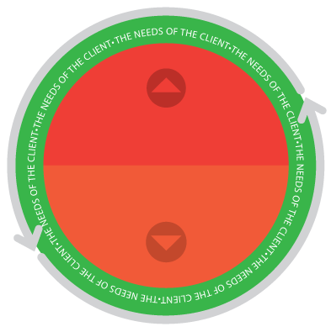
There’s a Hole in ‘Holistic’
Holistic Advisor:
Provides guidance for the whole of a client’s financial needs.
Accumulation Planning
Those who ignore retirement-specific risks may not live up to their duty to clients.
Income Planning
¹Speaker reference: Our summarization of Black Rock and Investment News Research, "2016 Elite RIA Study.“
²Speaker reference: Kristin Cook, William Meyer, and William Reichenstein, Financial Analysts Journal, "Tax-efficient Withdrawal Strategies," 2015.
Notes:
Much is made these days about the holistic approach to financial planning, which is meant to encompass the whole of a client's financial needs. But it's surprising how few advisors--even those who embrace this holistic approach--focus on retirement income planning as part of such a model.¹ <Click>Once the accumulating has ended and the consuming has begun, an advisor who can meet the unique challenges of retirement income planning will be of enormous value - for example, recent studies on the ordering of withdrawal from different types of accounts - taxable, tax-deferred, and tax free - have shown that a sophisticated approach to income planning can make the same amount of assets last an extra six years or longer.² And with potential new requirements of advisors as fiduciaries, <Click> those who ignore retirement-specific risks may not live up to their duty to clients.

Slide 11
Volatility is Volatility, Right?
Accumulation Planning
≠
Income Planning
Notes:
But let's take a closer look at what we mean when we talk about accumulation thinking vs. income thinking. In traditional accumulation planning, portfolio volatility is an important concern--and one might contend that portfolio volatility is a great proxy for income volatility. Volatility is volatility, right? But if we examine this assumption, we’ll see it simply doesn’t hold water. The two are not as related as you’d think.

Slide 12
Portfolio and Income Volatility
2016, 957.8%
T-Bills Income Volatility
Example:
2011:
$1000/month
2012:
$1430/month
2013:
$571/month
Chart source: 30-year T-Bill performance.
¹Speaker reference: 30-year T-Bill performance.
²Speaker reference: Robert C. Merton, "The Crisis in Retirement Planning," July-August, 2013.
Notes:
Let’s look at an example. Those who study portfolios often talk about the “risk-free” asset and the “risk-free” rate. Usually, they use something like US Treasury Bills--essentially, cash—as a concrete example. “Risk-free” in this context means there is no variation to a portfolio’s nominal value. So, a $1 million portfolio of T Bills would have maintained a remarkably stable value over the years. Low risk, right? Not so fast.
Since 1990, a $1 million T-Bill portfolio would have provided a high of $78,135/year and a low of $163/year. Not so risk free, right?¹ Merton argues that investors, retirement plan sponsors, and even advisors are focused on the wrong thing. They’re not focused on income risk. ²
If we look only at income risk, a much better example of this type of income asset would be a Single Premium Immediate Annuity, or SPIA. In a basic income annuity, the value of annual income does not vary. An inflation-adjusted SPIA would therefore be the hypothetical risk-free income asset.
If we make the shift from accumulation language to income language, we shouldn't be focusing on how clients would feel or react if their account balance went down by 10, 20, or 50%. We should determine their income risk appetite. How would they react if their income went down by 10, 20, or 50%? To do otherwise is to solve the wrong problem entirely.

Slide 13
Yesterday’s Retirement Income Planning
APPROACH #1:
APPROACH #2:
Focus on a number
The conventional 4% Rule
The amount you need to retire is this…”
I’d go with the 4% Rule – I hear it’s a sure thing!
Notes:
Let’s dive a bit deeper into the current level of public discourse around retirement income—the conventional wisdom that Merton was trying to challenge. We often see two common approaches to retirement income:
Focus on an accumulation “number”.
Go with the 4% rule - which its proponents say is a simple, sure thing
In the first case, pundits bring an asset allocation weapon to a consumption fight. This approach assumes it’s possible to come up with one number that will solve retirement for a given investor. But that’s not true.

Slide 14
Why There is No “Number”
A gap of just 3 years, 10 months meant a nearly 50% increase in the cost of income.
Chart Source: Cannex Pay Index.
The Cannex Pay Index is meant to provide an indication of the lifetime yield that a retiree can expect from a single premium income annuity (SPIA). The Cannex Pay Index is unmanaged and not available for direct investment. Past performance is no guarantee of future results.
Notes:
For example, the amount required to fund a certain spending level—say, $50,000 per year in 2016 dollars—has varied widely over time. Here we see what it would have taken historically for a couple aged 70 and 65 to fund a $50,000/year SPIA. From 2008 to 2012 – less than four years, the cost of this spending went up by nearly 50%. Who’s to say the number you have in mind now will fund the retirement you want if that retirement doesn’t start for 10 or 20 years?

Slide 15
Yesterday’s Retirement Income Planning
The conventional
“4% RULE”
You can live off of 4% of your assets per year, adjusted for inflation, throughout retirement.
Our faith in the 4% rule could be misplaced and our understanding of what it means may be wrong.
Notes:
Of course, many believe an immediate annuity is not a good fit for their clients and that they have a good way to arrive at a "retirement number." They assume that a retiree can live off of 4% of their assets per year, adjusted for inflation, throughout retirement. This “4% rule” has become standard. But, I'm about to show you that our faith in the 4% rule may be misplaced and our understanding of what it means is wrong.
But before diving into the 4% rule, let’s understand why it's important in the first place. It’s essentially an attempt to reduce the sequence of returns risk for a retiree.

Slide 16
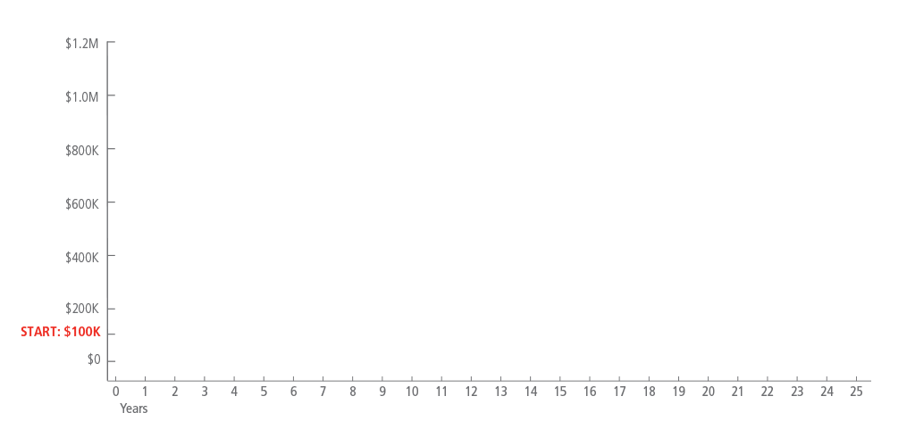
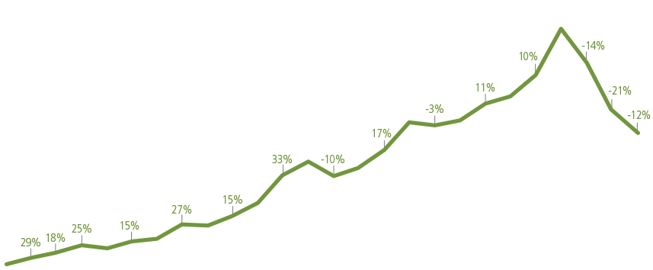
Sequence of Returns Risk
This chart is hypothetical. The average annual return is equal to 8.0% in both scenarios and does not reflect the performance of an actual product or account, or the taxes and other fees that, if applied, would reduce performance. Performance over the time period shows an inverse relationship between Accounts A and B.
Notes:
"Sequence of returns" risk arises only if there are cash flows to or from an account. In this example we see the exact same set of annual returns applied to a $100,000 account. The difference is that in the first example, the good returns come first, with poor returns late. <Click>In the lower example, the bad returns come first. But, as you can see, it doesn't really matter. With no additions or subtractions of cash the paths end up in the same place.

Slide 17
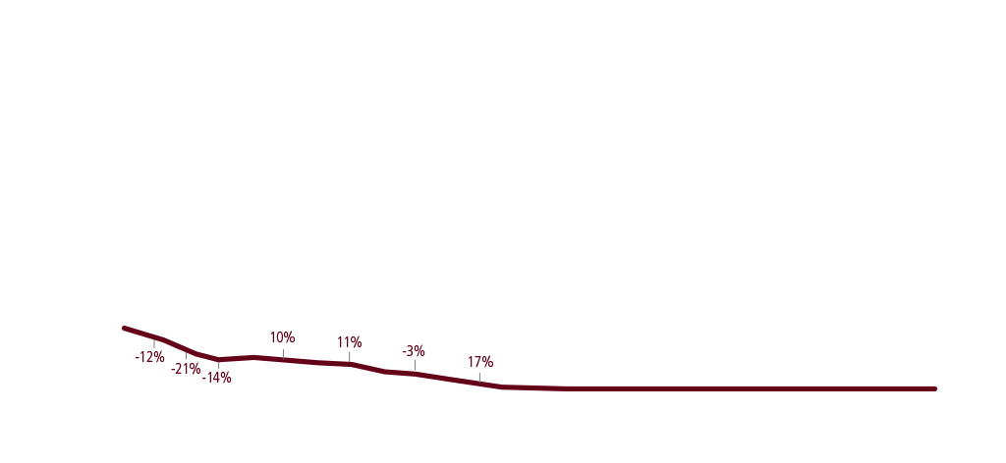
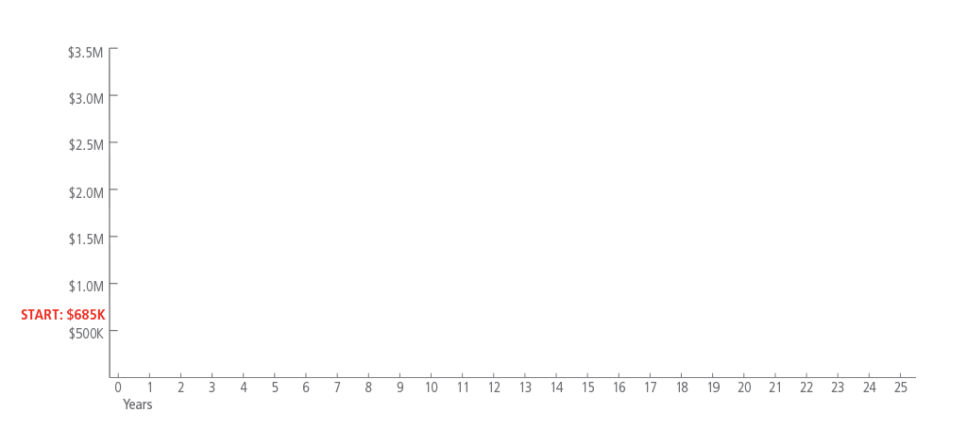
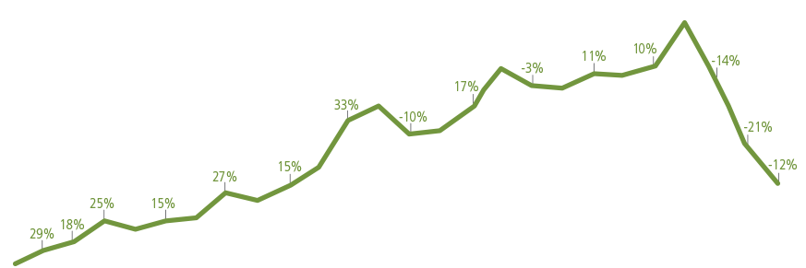
Sequence of Returns Risk
During the distribution phase, each hypothetical account is adjusted for the annual return indicated in the Before Retirement chart, then reduced according to a 5%
hypothetical withdrawal at the end of each year. Starting in year two, the withdrawal amount is increased each year by 3% for an assumed rate of inflation.
Notes:
But as soon as we introduce withdrawals, the order of returns has a huge effect on where we end up. Poor early returns lead account B to run out of money by year 12, even though the withdrawals from both accounts are identical.

Slide 18
Sequence of Returns in History
A 70/30 Stock/Bond portfolio grows from $100,000 to over $300,000 from 1997-2014.¹
30% Bonds
70% Stock
Chart Source: 70% MSCI World Index, 30% Bank of America Merrill Lynch U.S. Treasury Index.
The MSCI World Index is a broad global equity benchmark that represents large and mid-cap equity performance across 23 developed markets countries. The MSCI World Index is unmanaged and not available for direct investment. The Bank of America Merrill Lynch U.S. Treasury Index is an unmanaged index that tracks the performance of the direct sovereign debt of the U.S. Government and is not available for direct investment. Past performance is no guarantee of future results.
¹Speaker reference: James M. Sanford, Chicago Tribune, "The Strong Case Against Annuities," June 23, 2016.
Notes:
But has this sort of thing mattered historically? Well, let’s look at an actual example from history.
A recent article in the Chicago Tribune noted that a 70/30 stock/bond portfolio would have allowed $100,000 to grow to over $300,000 from 1997 to 2014.¹ This historical accumulation fact is put forward as evidence that this portfolio works in retirement.
Bank of America Merrill Lynch U.S. Treasury Index

Slide 19
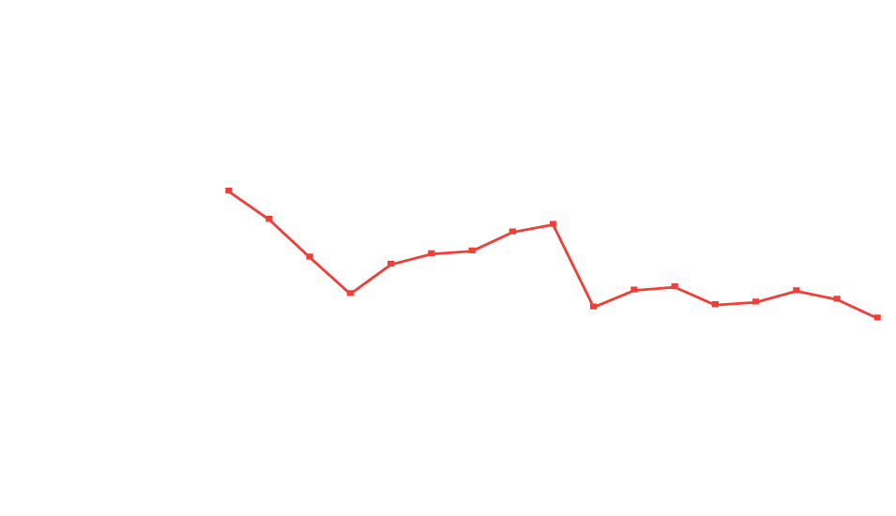
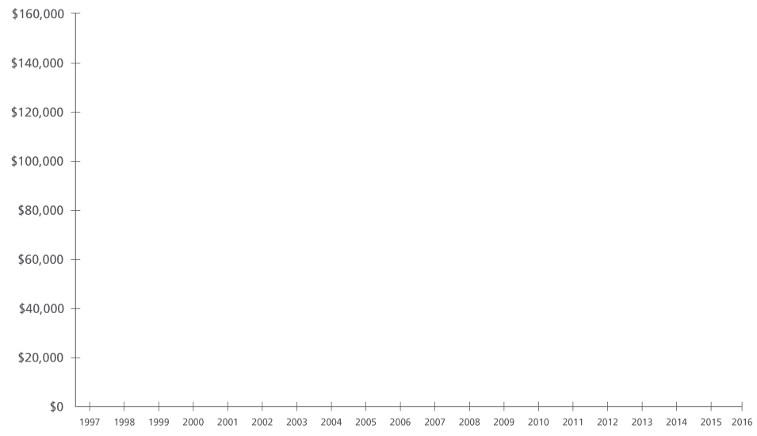
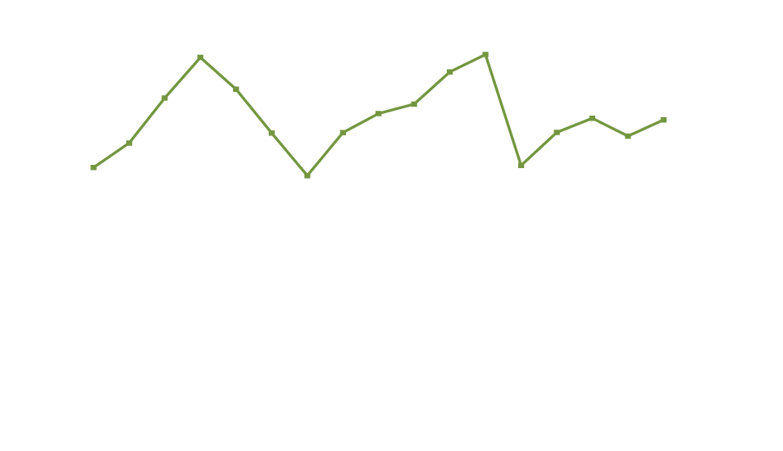
Sequence of Returns in History
70/30 Portfolio
($100,000 value, 4%/Year withdrawal adjusted for inflation)¹
1997 - 2013
2000 - 2016
Ending Value 2013: $118,479
Ending Value 2016: $57,382
¹ Chart Source: 70% MSCI World Index, 30% Bank of America Merrill Lynch U.S. Treasury Index.
The MSCI World Index is a broad global equity benchmark that represents large and mid-cap equity performance across 23 developed markets countries. The MSCI World Index is unmanaged and not available for direct investment. The Bank of America Merrill Lynch U.S. Treasury Index is an unmanaged index that tracks the performance of the direct sovereign debt of the U.S. Government and is not available for direct investment. This chart is hypothetical, for illustrative purposes only. Past performance is no guarantee of future results.
Notes:
Now, take that same portfolio and factor in a yearly 4% withdrawal with a 3% inflation adjustment. If begun in 1997, the portfolio would have been worth nearly $118,479 16 years later. We get our 4% withdrawal, and we end up with more than we started with. Impressive.
<Click>But let’s take that same portfolio with the same spending pattern and begin three years later, in 2000. This account would have been worth just shy of $57,382 after 16 years.
A three year difference in retirement date would have meant nearly 52% less in the account after just 16 years.
So not only did the Tribune article cherry-pick its time period, but it ignored the reality that most people add to and subtract from their portfolios. That's a simplification that can be very dangerous!

Slide 20
Retiring at the Wrong Time
“
…Markets don’t have to go down and stay down to ruin your retirement. All you need is a bear market at the wrong time, and the sustainability of your income can be cut in half.¹
“
Moshe A. Milevsky, Ph.D. "Confessions of a VA Critic”
So, what’s the problem?
¹Moshe A. Milevsky, Research Magazine, "Confessions of a VA Critic," January 1, 2007.
Notes:
The problem, of course, is we have no idea if a client’s chosen retirement date will be good or bad for their portfolio. We only know that in retrospect. So we should plan to prepare them in case they just happen to retire at a bad time.

Slide 21
“
I only let my clients take a sustainable withdrawal rate.
“
4%?
Notes:
Those of you who know and understand sequence of returns might be thinking, “I already take this stuff into account. That’s why I only let my clients take a sustainable withdrawal rate.”
<Click>Let me guess. Somewhere around 4%?

Slide 22
The 4% Rule
William Bengen, developed the 4% Rule in 1994.
Speaker reference: Our summarization of information from William P. Bengen, "Determining Withdrawal Rates Using Historical Data," October 1994.
Notes:
The so-called 4% rule, initially developed by William Bengen in 1994, has become engrained in the culture of retirement planning. It is routinely cited as prudent to withdraw 4% of your retirement-date portfolio and adjust this amount for inflation throughout retirement. But have you ever actually examined how the rule was derived or what it means?
First, it’s important to understand that the rule was produced using rolling 30-year periods from 1929 to 1991, with gross asset class returns from Ibbotson. From this we note that:
The “rule” holds using historical return streams , and doesn't take current market conditions into account.
The 4% rate does not include fees and taxes.
It would be worthwhile to ask how the rule would hold up if we update the return assumptions using modern Monte Carlo analysis to find a safe withdrawal rate—instead of just historical periods. Would 4% still be deemed ‘acceptable’, or was this a historical accident?
It’s also worth asking how much a retiree could actually spend from a 4% withdrawal, or any level of withdrawal, if fees and taxes are included.

Slide 23
Breaking the 4% Rule
4%
1% Advisory Fees
2 to 2.5%
Net of Fees
.5 - 1%
Underlying Investment Fees
2 to 2.5%
Net of Fees
Chart source: Jason Zweig, Wall Street Journal, "Why You're Paying Too Much in Advisory Fees," June 19, 2015.
Notes:
Let’s take the second of these first.
<Click>If we assume a 1% advisory fee based on Assets Under Management, <Click>and a half-percent to one percent for fees on underlying investments, <Click>we’re left with two to two-and-a-half percent net of fees and gross of taxes.
<Click>If we assume a 15-25% effective tax rate, <click>we’re left with slightly more or less than two percent in spendable money.

Slide 24
Breaking the 4% Rule
2 to 2.5%
Net of Fees
.5 - 1%
Underlying Investment Fees
2 to 2.5%
Net of Fees
Chart source: Jason Zweig, Wall Street Journal, "Why You're Paying Too Much in Advisory Fees," June 19, 2015.
Notes:
Let’s take the second of these first.
<Click>If we assume a 1% advisory fee based on Assets Under Management, <Click>and a half-percent to one percent for fees on underlying investments, <Click>we’re left with two to two-and-a-half percent net of fees and gross of taxes.
<Click>If we assume a 15-25% effective tax rate, <click>we’re left with slightly more or less than two percent in spendable money.

Slide 25
Breaking the 4% Rule
2 to 2.5%
Net of Fees
2 to 2.5%
Net of Fees
Chart source: Jason Zweig, Wall Street Journal, "Why You're Paying Too Much in Advisory Fees," June 19, 2015.
Notes:
Let’s take the second of these first.
<Click>If we assume a 1% advisory fee based on Assets Under Management, <Click>and a half-percent to one percent for fees on underlying investments, <Click>we’re left with two to two-and-a-half percent net of fees and gross of taxes.
<Click>If we assume a 15-25% effective tax rate, <click>we’re left with slightly more or less than two percent in spendable money.

Slide 26
Breaking the 4% Rule
2 to 2.5%
Net of Fees
15% to 25% Taxes
1.5% to 2.1% Net Spendable
Chart source: Jason Zweig, Wall Street Journal, "Why You're Paying Too Much in Advisory Fees," June 19, 2015.
Notes:
Let’s take the second of these first.
<Click>If we assume a 1% advisory fee based on Assets Under Management, <Click>and a half-percent to one percent for fees on underlying investments, <Click>we’re left with two to two-and-a-half percent net of fees and gross of taxes.
<Click>If we assume a 15-25% effective tax rate, <click>we’re left with slightly more or less than two percent in spendable money.

Slide 27
Breaking the 4% Rule
1.5% to 2.1% Net Spendable
Chart source: Jason Zweig, Wall Street Journal, "Why You're Paying Too Much in Advisory Fees," June 19, 2015.
Notes:
Let’s take the second of these first.
<Click>If we assume a 1% advisory fee based on Assets Under Management, <Click>and a half-percent to one percent for fees on underlying investments, <Click>we’re left with two to two-and-a-half percent net of fees and gross of taxes.
<Click>If we assume a 15-25% effective tax rate, <click>we’re left with slightly more or less than two percent in spendable money.

Slide 28
Breaking the 4% Rule
=
A $1 Million Portfolio
Produces $15,000 to $21,000 Spendable Annually
1.5% to 2.1% Net Spendable
Chart source: Jason Zweig, Wall Street Journal, "Why You're Paying Too Much in Advisory Fees," June 19, 2015.
Notes:
Let’s take the second of these first.
<Click>If we assume a 1% advisory fee based on Assets Under Management, <Click>and a half-percent to one percent for fees on underlying investments, <Click>we’re left with two to two-and-a-half percent net of fees and gross of taxes.
<Click>If we assume a 15-25% effective tax rate, <click>we’re left with slightly more or less than two percent in spendable money.
<Click>To put that in context, a $1 million portfolio would produce somewhere between $15,000 and $21,000 in spendable dollars. Does your $1 million client expect to spend more than about $1,700/month?

Slide 29
Breaking the 4% Rule
In order to produce 4% spendable:
6.2 - 7.3% Gross Withdrawal
2.2 – 3.3% Taxes and Fees
4% Net Withdrawal
¹Speaker reference: William P. Bengen, "Determining Withdrawal Rates Using Historical Data," October 1994.
Notes:
Working in reverse, <click>to produce $40,000 in spendable dollars, we would need closer to a 6 to 7 percent gross annual drain on a $1 million account.
Even using Bengen's original numbers, a 6% withdrawal rate would have failed in more than 60% of historical scenarios.¹
But Bengen's research was conducted using data from a very different financial climate. Many things have changed, particularly interest rates.

Slide 30
The New Reality
Chance of Success over 30-Year Retirement¹
Stock / Bond% Mix
Withdrawal Rate | 100/0 | 75/25 | 50/50 | 25/75 | 0/100
3% | 90 | 95 | 98 | 99 | 98
4% | 77 | 80 | 84 | 82 | 55
5% | 60 | 59 | 53 | 31 | 8
6% | 45 | 38 | 23 | 4 | 1
7% | 31 | 21 | 8 | 0 | 0
8% | 20 | 11 | 2 | 0 | 0
More Likely
Less Likely
¹Wells Fargo, "Withdrawal Rates and Your Retirement," 2015.
²Speaker reference: Michael Finke, Wade D. Pfau, David M. Blanchett, "The 4% Rule is Not Safe in a Low-Yield World," January 2013.
Notes:
This chart, <click>based on a Monte Carlo simulation study by Wells Fargo, used historical average asset class returns to generate 50,000 possible future scenarios.
In this study based on a 50/50 portfolio, the 4% rule has an 84% chance of success before fees and taxes and a 23% chance of success if we assume fees and taxes account for an additional 2%, a conservative estimate. Even this difference between gross and net calculations is shocking. However, if instead of historical averages we ground the Monte Carlo analysis within a long-term low interest rate environment such as that found in many of the years after the financial crisis, the 4% gross withdrawal has just a 43% chance of success – about half of the chances found using historical numbers, and a 6% return has just a 6% chance of success.²

Slide 31
Important Disclosures
The projections or other information generated for each Portfolio Withdrawal Rate regarding the likelihood of various investment outcomes are hypothetical in nature, do not reflect actual investment results, and are not guarantees of future results and may vary with each use and over time. The Portfolio Withdrawal Rates chart does not reflect and may not be used to promote any specific investment product. The results do not reflect expenses (i.e., commissions, advisory fees, and mutual fund expenses) associated with a particular investment. Taxes have not been taken into consideration.
The Probability Analysis (commonly referred to as Monte Carlo) simulation generates random returns based on the historical standard deviation forming a normal distribution around the mean. After returns for each asset class are generated, the returns are further refined by factoring in approximate historical correlations between the asset classes. This will result in a universe of returns for each asset class. The portfolio’s weighted average return is calculated based on each asset class’ weight in that scenario’s asset allocation, in effect rebalancing every year.
To generate the percent chance of success for each allocation and each portfolio withdrawal rate, 50,000 scenarios were generated. All scenarios that had an ending balance equal to or greater than $0 were considered successful. Each scenario that had an ending balance less than $0 was considered a failed scenario. The number of successful scenarios, based upon the 50,000 scenarios generated, established the percent probability of an allocation meeting the withdrawal rate. Using identical assumptions, the mathematical process used in the Portfolio Withdrawal Rates grid can be replicated.
The asset classes utilized for Portfolio Withdrawal Rates illustration are listed below. Any additional asset classes from this time period, whether they have similar, inferior, or superior characteristics, have not been taken into consideration.
Capital Market Assumptions
Capital Market Assumptions for all asset classes assume a broadly diversified portfolio generally representative of the risks and opportunities of the asset class. To the extent that the investor's portfolio is not as diversified as the assumptions made for the asset class, the return and risk potential for the portfolio may vary significantly from the assumed Capital Market Assumptions.
The Capital Market Assumptions used within this illustration are based on a building-block approach of risk premiums and Sharpe Ratio Equivalency. The returns for each asset class reflect the premium above the short-term risk-free rate of return that investors are likely to demand in order to compensate for the risk of holding those assets. Sharpe ratio equivalency provides a consistent comparison or long-term risk premium across various asset classes for a 10-15 year time horizon or a period, covering more than one economic cycle. These long-term assumptions may differ greatly from the short-term performance and volatility experienced by your actual investment holdings. There are no assurances that the estimates will be achieved. They have been provided as a guide to help you with your investment planning.
Notes:
(Read slide)

Slide 32
Important Disclosures
Representative index is provided to clients as an example of a public index that generally reflects the associated asset class. Capital Market Assumptions are not based on the Representative Index. You cannot invest directly in an index.
This chart is for illustrative purposes only. Investors incur expenses when investing (i.e., commissions, advisory fees, and mutual fund expenses). Figures do not reflect the effects of taxes or transaction costs.
Asset Class | Downside Risk | Average Annual Return | Representative Index
Large Cap Blend | -16.5% | 8.0% | S&P 500
Intermediate Taxable | -5.0% | 4.1% | BarCap US Govt/Credit
Fixed Income |  |  | Interm. TR USD (% Total Return)
Notes:
(Read slide)

Slide 33
Longevity Is Getting Longer¹
For the last 160 years, human longevity has increased at a rate of 6 hours per day for women.
Growth is slightly slower at 5 hours 20 minutes per day for men.
Predictions of an absolute limit to human longevity have, on average, been exceeded within 5 years of that prediction.
¹James W. Vaupel, Kristin G. v. Kistowski, Aging Horizons, "Broken Limits to Life Expectancy."
Notes:
Now that we’ve reviewed how portfolios, income production, and safe withdrawal rates have changed, let’s turn to another way that retirement income planning is different. Unlike other liabilities that we can plan for, like a car or a house, we don’t actually know how much we’ll need in retirement. Why? Because we don’t know how long we’ll live!
Along with sequence of return risk, longevity risk is the other major retirement liability. And, just like markets, longevity continues to evolve.

Slide 34
Longevity Misunderstood
LIFE EXPECTANCY¹
From birth: 76 for males, 81 for females
From age 65
Male: 83
From age 65
Female: 85
¹Social Security Administration, Actuarial Life Table, August 2013.
²Speaker reference: National Academies Press, "The Growing Gap in Life Expectancy By Income," 2015.
Notes:
Unfortunately, this is another poorly understood topic. <click>Media reports almost always quote life expectancy from birth in their discussion of retirement. But this is misleading. A person about to retire at age 65 has a much higher life expectancy than they did as a newborn baby.
<click>For example, today’s newborns have a life expectancy of 76 for males, 81 for females. <click>Today’s 65 year olds add 7 and 4 years, respectively.

Slide 35
Longevity Misunderstood
LIFE EXPECTANCY
From age 50²
Bottom 20% of Wage Earners
78
Top 20% of Wage Earners
92
¹Social Security Administration, Actuarial Life Table, August 2013.
²National Academies Press, "The Growing Gap in Life Expectancy By Income," 2015.
Notes:
But we can't stop there. There is a huge longevity gap in the US based on socio-economic factors. For example, <click>a 50 year old woman in the bottom 20% of wage earners has a life expectancy of 78 while a <click>50 year old woman in the top 20% of earners can expect to live to 92—14 years longer! It's important to consider life expectancy data that actually apply to your clients.²

Slide 36
What is Life Expectancy?
Median
Exceed Life Expectancy
Notes:
But, what is life expectancy? It’s the median (50th percentile) of expected age at death. So half the population of 65-year-olds is expected to live beyond what we call life expectancy. Some much longer.

Slide 37
What is Life Expectancy?
Exceed Life Expectancy
Notes:
In fact, we should probably be discussing the range of life expectancies with our clients, not just the 50th percentile.

Slide 38
What is Life Expectancy?
25% expected to live past 97¹
¹Merrill Lynch, "Annuities for Lifetime Income," 2016. Merrill Lynch Wealth Management, IMG Retirement Strategies calculations based on Society of Actuaries, 2012 Individual Mortality Tables, Basic.
Notes:
For example 25% of 65 year old couples will have one spouse live to age 97 or later.
So the question is, what age should you plan for?

Slide 39
Retirement Income Pitfalls: In Review
1
Accumulation vs. Income Thinking:
Different measurements of risk and success
2
The 4% Rule:
Isn’t as safe as you might think
3
Longevity:
Often misunderstood
Notes:
Before we begin to answer some of these questions, let’s review what we’ve discussed. We’ve identified some ways that the current understanding of retirement income planning is flawed.
1. Accumulation thinking vs. income thinking: Our focus on the wrong measures can lead to failure to address the right problem: providing dependable funding for spending needs. By focusing on the wrong measurements of risk and success, we risk failing to provide what retirees need.
2. <Click>Misplaced faith in the 4% rule: This rule of thumb is based on gross returns from the past. Updated to today and accounting for taxes, fees, and inflation, 4% could be a very risky proposition.
3. <Click>Planning for longevity: Many fail to consider what life expectancy really is, let alone quote a realistic number.
So now let’s turn to some tools that advisors can use to become true retirement income planning specialists. We want to help you develop the tools to truly help your clients, and help you to communicate that value to clients and prospects.

Slide 40
Ways of Addressing Longevity
CONSERVATIVE ESTIMATE
OFFICIAL NUMBERS
LIFE EXPECTANCY CALCULATORS
Notes:
First, let’s continue our discussion of longevity. How should we talk about this with clients and how can we come up with a reasonable number to use in our planning?
Options are plenty. You could simply use the same estimate for everyone, such as age 100.
<Click>If you want to dig deeper, you could use government or actuarial-table life expectancies. <Click>Or you could take advantage of the wide array of life expectancy calculators freely available. Some are fairly simple. Others go into great detail on medical and family histories. You may also consider developing your own hybrid of these options.

Slide 41
How You Consume Money Matters
Unsophisticated
APPROACH
Conventional
WISDOM
Tax-Free
Non-qualified funds
Tax-deferred
Tax-deferred
Non-qualified funds
Adds 3 years of income¹
Tax-Free
¹Kirsten A. Cook, William Meyer, William Reichenstein; Financial Analysts Journal, "Tax-Efficient Withdrawal Strategies," 2015.
Tax deferral offers no additional value if an annuity is used to fund a qualified plan, such as a 401(k) or IRA. It also may not be available if the annuity is owned by a “non-natural person” such as a corporation or certain types of trusts.
Notes:
Next, let’s talk about doing more with the assets clients do have.
Conventional wisdom has it that retirees should first tap their non-qualified, taxable accounts, followed by tax-deferred accounts like IRAs, followed by tax-free accounts like Roths. However, recent evidence shows that this approach is flawed and those with professional help can do better.
To be sure, this conventional wisdom does improve retirement outcomes compared to the reverse order of withdrawals. <Click>Following the conventional order would add 3 years over the reverse.

Slide 42
How You Consume Money Matters
Sophisticated
BRACKET MANAGEMENT
Non-Qualified Funds
Tax-Deferred
Tax-Free
Adds 6 years of income¹
¹Kirsten A. Cook, William Meyer, William Reichenstein; Financial Analysts Journal, "Tax-Efficient Withdrawal Strategies," 2015.
Tax deferral offers no additional value if an annuity is used to fund a qualified plan, such as a 401(k) or IRA. It also may not be available if the annuity is owned by a “non-natural person” such as a corporation or certain types of trusts.
Notes:
However, sophisticated tax bracket management can add 6-plus years of income compared to an unsophisticated approach.

Slide 43
Bracket Management
Use tax-deferred assets to fill up the lower tax brackets whenever possible, e.g., earlier in retirement.
Tax-deferred
Assets
RETIREMENT YEARS
If never taxed above 15%...
Tax deferral offers no additional value if an annuity is used to fund a qualified plan, such as a 401(k) or IRA. It also may not be available if the annuity is owned by a “non-natural person” such as a corporation or certain types of trusts.
Notes:
Bracket management is based on the idea that tax-deferred assets should be used to fill up lower tax brackets whenever possible. <Click>In practice, this will mean tapping tax-deferred assets earlier in retirement – but only to a point. If, through bracket management, tax-deferred growth is never taxed above the 15% level, for example, years can be added to an average retirement.

Slide 44
Don’t Try This At Home
A professional could help a retiree implement this sophisticated withdrawal strategy.
Notes:
My colleagues and I would be happy to walk you through this process in more detail. We also have resources that can help you implement these ideas. But the main take-away today is that, with the help of a professional, a retiree could implement this sophisticated withdrawal strategy. The years added to a retirement are tangible evidence of the value you bring as a specialized advisor.

Slide 45
What Does Failure Look Like?
?
The Big Question:
Can we design a plan where “failure” is still an acceptable retirement?
Notes:
And when we discuss strategies to extend the life of retirement assets, it’s important to set some parameters for what success and failure look like in these scenarios.
Typically, the financial services industry uses too simplistic a method for evaluating the failure or success of an income plan—most commonly, running out of money near the end of life is viewed the same as running out of money at age 70. Both are considered a “failure,” but one is clearly more disastrous than the other. You can distinguish yourself and your practice from the rest of the industry by focusing not on the probability of failure, but on magnitude. In fact, with enough focus on magnitude of failure, you might be able to develop a plan in which "failure" doesn't have to mean "ruin“.

Slide 46
What Does Failure Look Like?
“Failure” Scenario with Annuity
Non-Guaranteed Income
Portfolio Value
Annuity
Social Security
Time
“Failure” Scenario without an Annuity
Non-Guaranteed Income
Portfolio Value
Social Security
Time
Chart source: Ibbotson, 2016.
These hypothetical examples are for illustrative purposes only and are not representative of the future performance of any product. Past performance is no guarantee of future results.
Guarantees are backed by the claims-paying ability of the issuing insurance company.
Annuities are long-term, tax-deferred vehicles designed for retirement. Variable annuities involve investment risks and may lose value. Earnings are taxable as ordinary income when distributed and may be subject to a 10% additional tax if withdrawn before age 59½.
Notes:
Any good retirement plan presentation should show a graph like this. We need to show clients where their income comes from. How much is guaranteed? How much is variable? How much can run out in a “failure” scenario.
<Click>We then need to ask what level of continued income in a failure scenario is acceptable to the client. It may be that we can design a plan in which failure – though not “plan A” by any means – is still a comfortable situation. If that’s true, a 10, 20, or even 30% chance of this failure scenario coming true isn’t necessarily reason for alarm. In that case, failure isn’t financial ruin – it’s just a slight change of plans.
For example, in the top chart here, you can see that even if your non-guaranteed investment income runs to zero, if your portfolio includes an annuity with guaranteed income, your income stream remains steady. Not as robust, but certainly not what you'd call "ruin."

Slide 47
The Annuity Approach
“
All of these researchers agree that life annuities are a legitimate and core product for the optimal retirement portfolio.
“
- Moshe A. Milevsky, PhD
Source: Moshe A. Milevsky, "Life Annuities: An Optimal Product For Retirement Income," 2013.
Notes:
Because of this unique ability to manage risks specific to retirement, economists agree that annuities are a legitimate and core product for a retirement portfolio.
But how can annuities – variable, fixed, indexed, and immediate – provide for a steadier income stream? The fact is, this kind of consistent income stream is really only available because of risk-pooling. Building your own longevity and consistent income stream in the derivatives market is virtually impossible.

Slide 48
The Advantages of Risk Pooling
Hypothetical case study: Couple, both age 65.¹
A simple example of product allocation at work: Traditional Systematic Withdrawal Plan from a balanced portfolio²
4.2%
But what if the clients aren’t comfortable with an 80% chance of success?
Achievable Spending Rate
Probability of Success
80%
¹Merrill Lynch, "Annuities for Lifetime Income," 2016.
²Hypothetical illustration based on Merrill Lynch Investment Management and Guidance research. A Systematic Withdrawal Plan is one that regularly draws down a percentage of the portfolio to provide income; and then regularly rebalance assets to a target allocation based on client risk profile and time horizon. Adjusted for inflation..
Notes:
<click>Without the advantages of risk pooling and longevity risk management, retirees are faced with a trade off between the level of income they want and the risk that they will run out of money. For example, this Merrill Lynch study shows that a 4.2% withdrawal might have an 80% chance of success. (Unfortunately, this scenario does not take low interest rates into account.)

Slide 49
How Risk Pooling May Increase Income and Decrease Longevity Risk
Hypothetical case study: Couple, both age 65.¹
4.2%
The trade-off between spending
and probability of success²
3.4%
But what if a 3.4% withdrawal rate doesn’t provide enough
income?
Achievable Spending Rate
Probability of Success
80%
95%
¹Merrill Lynch, "Annuities for Lifetime Income," 2016.
²Hypothetical illustration based on Merrill Lynch Investment Management and Guidance research. A Systematic Withdrawal Plan is one that regularly draws down a percentage of the portfolio to provide income; and then regularly rebalance assets to a target allocation based on client risk profile and time horizon. Adjusted for inflation..
Notes:
If this were too high of risk for someone, they could instead take 3.4% income and have a 95% chance of success.

Slide 50
How Risk Pooling May Increase Income and Decrease Longevity Risk
Hypothetical case study: Couple, both age 65.¹
4.75%
4.2%
3.4%
Achievable Spending Rate²
Variable Annuity
Probability of Success
80%
95%
Guaranteed Lifetime Income*
*Guarantees are backed by the claims-paying ability of the issuing insurance company.
¹ Merrill Lynch, "Annuities for Lifetime Income," 2016.
²Hypothetical illustration based on Merrill Lynch Investment Management and Guidance research. A Systematic Withdrawal Plan is one that regularly draws down a percentage of the portfolio to provide income; and then regularly rebalance assets to a target allocation based on client risk profile and time horizon. Adjusted for inflation.
Notes:
But, because risk pooling and longevity risk management can reduce risk and increase the amount of income someone can take, a third option would be to take, for example, a 4.75% income that is guaranteed for life for an additional fee and has the potential to grow with a high enough level of investment performance.
Of course other annuity options, with different income levels and liquidity characteristics would be possible as well. This example simply serves to show how, viewed in the context of the trade off between income amount and risk, including an annuity can enhance both of these factors: economic research shows that with annuities income risk is reduced and the amount of income available goes up compared to non-annuity systematic withdrawal plans. Because of this, if income level and income risk are important to a client, it may not be wise to exclude annuity options from the planning process entirely.

Slide 51
Important Disclosures
The projections or other information generated for each Traditional Systematic Withdrawal Plan regarding the likelihood of various investment outcomes are hypothetical in nature, do not reflect actual investment results, and are not guarantees of future results and may vary with each use and over time.
The Probability Analysis (commonly referred to as Monte Carlo) simulation generates random returns based on the historical standard deviation forming a normal distribution around the mean. After returns for each asset class are generated, the returns are further refined by factoring in approximate historical correlations between the asset classes. This will result in a universe of returns for each asset class. The portfolio’s weighted average return is calculated based on each asset class’ weight in that scenario’s asset allocation, in effect rebalancing every year.
The probability of success measures the likelihood that a retiree will be able to spend according to plan without exhausting his/her wealth. Spending is assumed to rise each year with inflation. Client is assumed to choose the allocation to stocks, bonds and cash that minimizes his/her expected lifetime shortfall –the amount, on average, he/she can expect to undershoot his/her lifetime spending plans. The analysis builds on assumptions regarding market risk, returns and mortality to provide guidance crafted to reflect age, gender and spending needs. It is based on return simulations for three asset classes: stocks, bonds and cash, as well as inflation. The simulations, based on historical experience, are calibrated so that the expected return and risk for each asset class matches Merrill Lynch Wealth Management’s Capital Market Assumptions for a 20-to-30-year horizon. The analysis further assumes annual asset management fees in line with the Lipper averages for mutual funds. It does not, however, take account of taxes.
Capital market assumptions used in analysis as of July 2011 are as follows:
U.S. Stocks is based on the S&P 500 Index –expected return 9.5%, expected volatility 18.0%, expected fees 1.5%. U.S. Bonds is based on Ibbotson U.S. Intermediate Government Bond Index –expected return 5.3%, expected volatility 6.1%, expected fees 1.5%. U.S. Cash is based on 1 month Treasury Bills—expected return 3.0%, expected volatility .9%, expected fees .5%. All fees based on Lipper data. Mortality assumptions based on Society of Actuaries, 2000 Mortality Tables.
Notes:
(Read slide)

Slide 52
The Annuity Strategy
?
?
?
Why aren’t annuities more popular?
Psychological research done in 2008 suggests framing may be the key
Source: Jeffrey R. Brown, Jeffrey R. Kling, Sendhil Mullainathan, Marian V. Wrobel, National Bureau of Economic Research, "Why Don't People Insure Late Life Consumption: A Framing Explanation of the Under-Annuitization Puzzle," January 2008.
Notes:
As I said economists consistently tout annuities as having high utility for retirees. They even have a term for why—despite this apparent utility—annuities are left out of many portfolios: The call it the Annuity Puzzle.
The reasons for leaving out annuities vary, but some psychological research shows that framing is key—in other words, the way you describe an annuity to a client.

Slide 53
The Annuity Strategy
Based on research conducted in 2008:
Framed as a pure investment 21% of people chose an annuity with lifetime income.
21%
But framed as a way to provide retirement income over a long period 72% chose an annuity with lifetime income.
72%
Source: Jeffrey R. Brown, Jeffrey R. Kling, Sendhil Mullainathan, Marian V. Wrobel, National Bureau of Economic Research, "Why Don't People Insure Late Life Consumption: A Framing Explanation of the Under-Annuitization Puzzle," January 2008.
Notes:
Framed as a pure investment—or an instrument intended to grow assets—21% of people chose an annuity with lifetime income.
But framed as a consumption strategy—<Click>or a way to provide retirement income over a long period—72% chose an annuity with lifetime income.
If this seems familiar, that’s because it’s very similar to what our friend Merton—the Nobel laureate—is urging us to do: We need to get accumulation thinking out of retirement income planning.

Slide 54
Tools and Resources
For help implementing these strategies— tax deferral, bracket management, distribution planning— tools and resources available.
YAY
YAY
YAY
YAY
YAY
YAY
YAY
YAY
YAY
YAY
YAY
Tax deferral offers no additional value if an annuity is used to fund a qualified plan, such as a 401(k) or IRA. It also may not be available if the annuity is owned by a “non-natural person” such as a corporation or certain types of trusts.
Notes:
The strategies we’ve discussed today can be of enormous value to your clients, but they’re not always easy to research, calculate and implement. But everything worthwhile takes some effort right? There are a wealth of resources available to help your clients get the most out of their retirement assets. There are a variety of resources available to provide support and education surrounding this and many other topics, and a variety of digital tools for advisors and investors can help illustrate the benefits and drawbacks of various complex strategies.

Slide 55
Important Disclosures
Before investing, investors should carefully consider the investment objectives, risks, charges and expenses of the variable annuity and its underlying investment options. The current contract prospectus and underlying fund prospectuses, which are contained in the same document, provide this and other important information. Please contact your Internal Wholesaler to obtain the prospectuses. Please read the prospectuses carefully before investing or sending money.
This material was prepared to support the promotion and marketing of Jackson® variable annuities. Jackson, its distributors and their respective representatives do not provide tax, accounting or legal advice. Any tax statements contained herein were not intended or written to be used, and cannot be used, for the purpose of avoiding U.S. federal, state or local tax penalties. Clients should contact their own independent advisors as to any tax, accounting or legal statements made herein.
Variable annuities are long-term, tax-deferred investments designed for retirement, involve risks and may lose value. Earnings are taxable as ordinary income when distributed and may be subject to a 10% additional tax if withdrawn before age 59½.
Guarantees are backed by the claims-paying ability of the issuing insurance company.
Tax deferral offers no additional value if an annuity is used to fund a qualified plan, such as a 401(k) or IRA, and may be found at a lower cost in other investment products. It also may not be available if the annuity is owned by a “non-natural person” such as a corporation or certain types of trusts.
Notes:
Let’s take a moment to go over these important disclosures just one more time.
(Read slide.)

Slide 56
Important Disclosures
Annuities are issued by Jackson National Life Insurance Company® (Home Office: Lansing, Michigan) and in New York by Jackson National Life Insurance Company of New York® (Home Office: Purchase, New York). Variable annuities are distributed by Jackson National Life Distributors LLC, member FINRA. May not be available in all states and state variations may apply. These products have limitations and restrictions. Contact Jackson for more information.
Jackson® and its affiliates do not provide legal, tax or estate-planning advice. For questions about a specific situation, please consult a qualified advisor.
Jackson is the marketing name for Jackson National Life Insurance Company and Jackson National Life Insurance Company of New York. Jackson National Life Distributors LLC.
Neither the presenter, the presenter’s employer, nor any of their affiliates should be considered to be providing legal, tax or estate planning advice. For questions regarding a specific situation, please consult a qualified advisor.
Notes:
(Read slide)

Slide 57
Important Disclosures
A message from the Florida Department of Financial Services
An entity that is required to be licensed or registered with the Florida Office of Insurance Regulation but is operating without the proper authorization is identified as an unauthorized insurer. All persons have the responsibility of conducting reasonable research to ensure they are not writing policies or placing business with an unauthorized insurer. Any person who, directly or indirectly, aid or represent an unauthorized insurer can lose their licenses or face other disciplinary sanctions. Please see section 626.901, Florida Statutes, to read the laws. Lack of careful screening can result in significant financial loss to Florida consumers due to unpaid claims and/or theft of premiums. Under Florida law, a person can be charged with a third-degree felony and also held liable for any unpaid claims and refund of premiums when representing an unauthorized insurer. It is the person's responsibility to give fair and accurate information regarding the companies they represent.
Notes:
Presenter please note:
If presenting a CE credit presentation in Florida please read slide.
If presenting a non-CE credit presentation in Florida or any other state, do not read slide, but make the following statement while the slide is still up, “Disclosure contained on this slide is not applicable because this presentation is not being conducted for Continuing Education credit(s).”

Slide 58
THANK YOU

