Slide 1
DIVORCE FINANCIAL PLANNING AND MEDIATION
AVOIDING CRITICAL FINANCIAL ERRORS
IN DIVORCE SETTLEMENTS
JANE E. MCAULIFFE, CDFA®, PRESIDENT OF COLLABORATIVE DIVORCE STRATEGIES
ATTORNEY KERRY I. RAFANELLI OF RAFANELLI LAW

Slide 2
Overview & Agenda
Why specialize in a Niche?
Why Divorce?
What is Divorce Financial Planning?
How does a Divorce work?
Financial Topics Specific to Divorce
Financial Planning Intricacies
Mediation and the Collaborative Approach
Questions

Slide 3
Being an Expert in a Niche – Why Divorce?

Slide 4
Why Divorce?
Money In Motion
Largest Financial Transaction of Most Lives set amidst the most emotionally chaotic time of those lives
Economic “irrationality” is completely rational in divorce
Intersection of financial products, compensation, taxes, cash flow analysis, forensic accounting, long term planning, behavioral finance, decision coaching…..
Altruistic reasons

Slide 5
Why do I need you if I have a lawyer?
Lawyers are trained to operate within the family code (“law”) of the jurisdiction they practice in. They learn and live it.
Lawyers may be unfamiliar with complicated compensation, business structure and financial products
Good lawyers realize there is a limit to their competency and will bring financial experts in to deal with financial issues.
If there are no minor children, the only thing to fight over in a divorce is money.

Slide 6
Why do I need you if I have a lawyer?
Help them avoid malpractice.
Sure their paralegal can fill out a net-worth statement. Can they review documents, develop a complete understanding of a family’s financial picture then formulate strategy and creative settlement options?
We work with your lawyer, not against them and we are not a replacement.
Lawyers offer the structure and guidnace necessary to fashion agreements, we offer the creative options and financial strategies necessary to ensure our clients get the best financial settlement possible.

Slide 7
Why do I need you if I have an accountant?
Accountants and Tax preparers look backward at what has happened in the past.
They may be unfamiliar with complicated executive compensation
Often do not engage in advisory type relationships
Rarely assist in looking forward at the ramifications of financial decision made today
Tax preparers may be completely ignorant of the intricacies of divorce

Slide 8
What is Divorce Financial Planning?

Slide 9
What is Divorce Financial Planning?
Divorce Financial Planning…is the intersection of expert financial analysis, financial planning and decision coaching with the unique and complicated financial intricacies of divorce in mind. Legal advisers offer the structure and guidance necessary to fashion agreements. Divorce Financial Planners offers the creative options, financial analysis and strategies necessary to ensure clients obtain the most financially advantageous settlement possible.

Slide 10
What is Divorce Financial Planning?
Financial Analysis
Strategy
Negotiation
Decision Coaching
Collaboration
Attorneys
Mental Health Professionals
Forensic Accountants
Trust and Estate Lawyers
Financial Planners
Investment Advisors

Slide 11
What is Divorce Financial Planning?
We help clients understand the short and long term financial consequences of settlement options.
We help level the playing field when one party feels at a disadvantage due to lack of financial knowledge or experience.
We help gather the data needed to make fully informed and intelligent decisions.
We help our clients and their attorneys strategize and build creative options to complicated settlement issues.
We help build complete and accurate pictures of the family financial dynamic.
We help conserve precious emotional and financial resources.
We help our clients plan for financial independence post-divorce and provide Clarity for your Financial Future.

Slide 12
What is Divorce Financial Planning?
We regularly provide the following services:
Net Worth Statements: data gathering and creation of detailed Net Worth Statements providing detailed guide to negotiations of asset and debt division including assistance with Declarations of Disclosures
Cash Flow Analysis: detailed budget and needs analysis including analysis of marital standard of living and assistance with Declarations of Disclosures
Income and Tax Projections: income tax planning, dependent exemption and support scenario comparisons, tax return and earning history reporting and analysis of income available for support

Slide 13
What is Divorce Financial Planning?
Pension Benefit Valuation and Analysis: defined benefit and defined contribution plan valuations, community property valuations, and analysis of immediate asset offset or plan division though Qualified Domestic Relations Order (QDRO)
Note: We do not prepare QDRO’s. More on that later
Asset Division Strategies and Tracking: detailed reporting and tax consequence analysis of asset division distributions including assistance with and tracking of qualified distributions. Unbiased and creative strategies to overcome difficult roadblocks to Asset Division and modeling of fiscal impact to family financial picture
Risk Assessment and Insurance Strategies: Placement of life insurance as security for child and spousal support

Slide 14
How does Divorce work?
Financial
Disclosure
Discovery
Division of Assets and Debts
Only set aside for reasons of fraud
Child Support
Court retains jurisdiction
Alimony
Court retains jurisdiction for certain time period

Slide 15
How does Divorce work?
Emotional
Different for everyone
One party, usually the one being left, moves slower through grief cycle than the other
Some say like death of a family member
Keep everything in perspective - Snow White rarely marries Jack the Ripper

Slide 16
How does Divorce work?
Process options for getting divorce
Litigation
Contested vs. Uncontested
Adversarial with settlement
Divorce Mediation
Collaborative Divorce

Slide 17
Divorce Mediation
Divorce Mediation, Co-Mediation and Mediation Consulting
Divorce Financial Planners can work three ways in mediation.
As a neutral financial issue mediator for parties with attorneys concentrating on creative settlement options and complicated financial analysis;
In conjunction with an attorney as co-mediator to offer creative settlement options, financial analysis and strategies;
As consultant to one party to help level the playing field around financial knowledge and experience, generate creative options and financial strategies for settlement and help the party obtain the most financially advantageous settlement possible.
Typical Tasks

Slide 18
Divorce Mediation
STYLES OF MEDIATION
FACILITATIVE: Mediator listens to both sides and makes informed suggestions based on professional experience
EVALUATIVE: Mediator listens to both sides and gives legal advice as to how those concerns would stand up in court
TRANSFORMATIVE: Mediator encourages both side to express their issues and encourages civility and active listening to reach an agreement

Slide 19
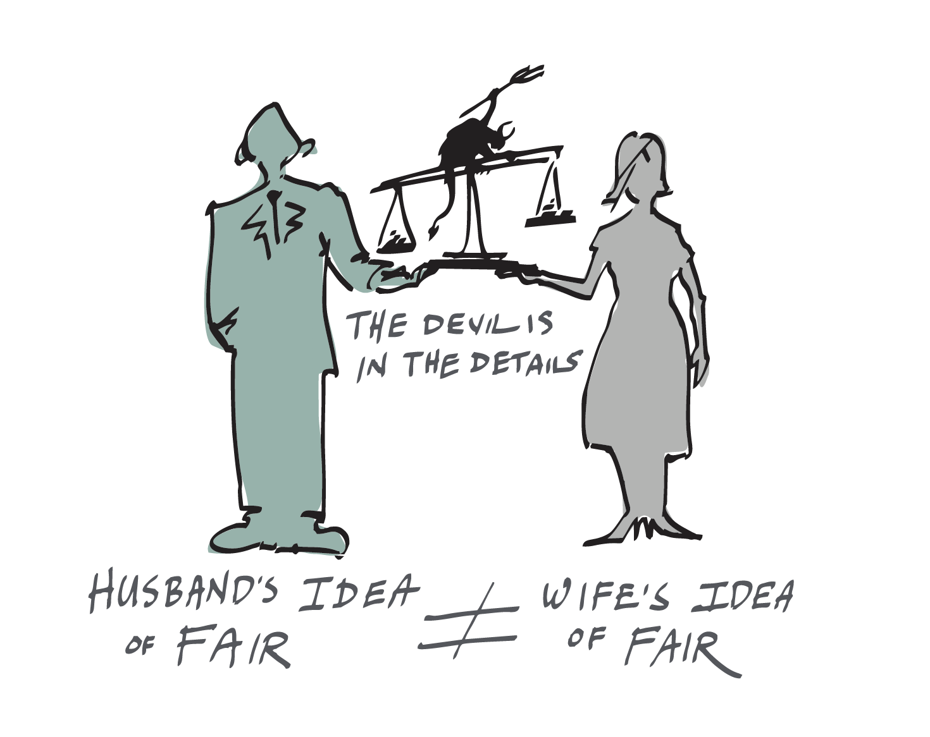
Why is Economic Rationality Rare in Financial Decisions of Divorce?
Everyone simply wants what is “FAIR”
Notes:
Hyperbolic Discounting is completely rational in the economics of divorce. People do weird things during and after divorce. We have seen people deliberately run a successful business into the ground to spite their former spouse. It is not uncommon for former spouses to go back to court every year to re-assess the appropriate level of spousal and child support payments. There is a very real value possibility taking less, or paying more, today will turn into a far better deal than the alternative when your client incorporates the emotional and economic costs of ongoing litigation and ambiguity of the outcomes.

Slide 20
CASE STUDY EXAMPLES AND QUESTIONS
Thank you for attending!

Slide 21
Contact Information
Jane E. McAuliffe, CDFA®
Collaborative Divorce Strategies
197 Warren Avenue, Suite 203
East Providence, RI 02914
jmcauliffecds@gmail.com
401-258-8737
Kerry I. Rafanelli, Esq.
Rafanelli Law Offices
670 Main Street, Unit C-3
East Greenwich, RI 02818
kerry@krafanellilaw.com
401-398-8388

